Slide 1

Python Training
Session 1 – Basics of Python

Slide 2
Part 1: Doing Things With Python

Slide 3
What is Python Good For?
Don’t think of Python as a programming language.
Python in its simplest form, is a calculator, with scripting capabilities.
At its most advanced, Python can be used to make software, to build websites, run servers and more.

Slide 4
How to Launch Python
On Windows:
Install Python 3.4+ from www.python.org.
Note: Remember to select “Add Python Directory to Path” when installing.
Start Menu > Run > Powershell
Type “python”, in small letters, and hit enter.
On Linux
You might already have one or more versions of python installed.
Type python or python3 in your terminal to start the interpreter.

Slide 5
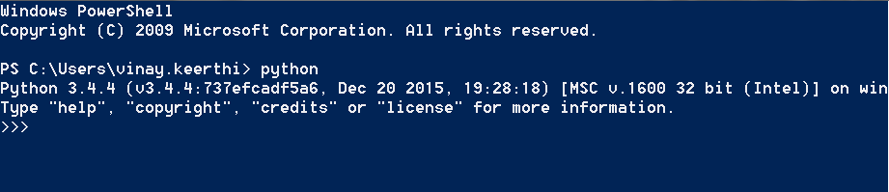
Python Interpreter: Windows

Slide 6
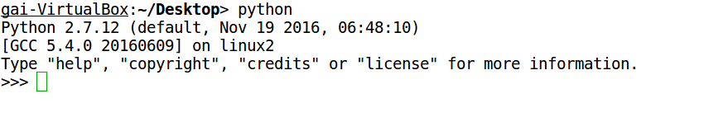
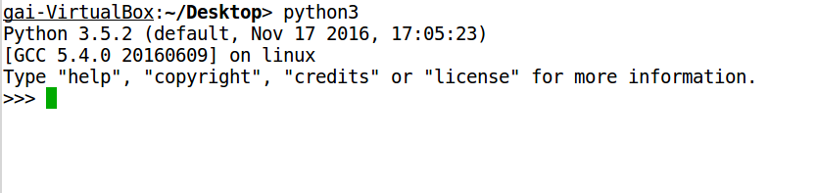
Python Interpreter: Linux

Slide 7
Python Interpreter
An “Interpreter Shell” can be used as a calculator, or as a prototype environment for your scripts.
It is not to be used for production level scripts, but to test your ideas.
However, you can use it instead of opening a calculator on your computer.
It’s easier, once you get used to it.
Let’s try it out.

Slide 8
General Note
This session is meant to be interactive. Please type all that you see here, exactly as it is given. If you have any queries, please feel free to ask.

Slide 9

Python Interpreter
The “>>>” sign is a prompt. In a command line, a prompt is used to signal to the user to type something.
So go ahead and type a number and press ENTER.
In the interpreter, every command you type is interpreted, and the value is printed right there.
Typing 1, returns 1, which is the value of the number.
Go ahead and try typing a word.

Slide 10

Python Interpreter
If you typed a word and got a similar message, do not be alarmed.
This is normal. Don’t panic.
What you typed, wasn’t a “word”. At least, not the way you assumed it would have been.
Typing a “word” without quotation marks, in Python, indicates that you’re attempting to use a variable. A variable is a keyword, a pseudonym for something else.
It holds a value that can be attached to it.

Slide 11

Python Interpreter
A variable can hold any kind of value. Try this.
You’ll see that the interpreter didn’t print the value of a here. Instead, it just returned another prompt.
To see the value of a just type this.
The difference between the first step and this is that the first one was an assignment step, which just assigns the value on the RHS to the variable on the LHS. Kind of like Algebra.
The second step just asks for the value of the variable, which the interpreter prints out.

Slide 12
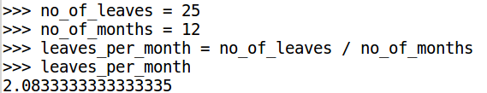
Python Interpreter: Some Math
Try these:
Depending upon your version of Python, the value below will differ. That’s all right. We’ll get to it later.
Try out some more math. Here are the operators for you.
+ Addition
- Subtraction
* multiplication
/ (not \) division
** power
() parethesis. Used for separating blocks.
Remember: BODMAS: "B"rackets, "O"f or "O"rder, "D"ivision, "M"ultiplication, "A"ddition and "S"ubtraction.

Slide 13
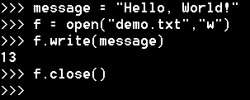

Python Interpreter: Files
Python can be used to read information in a file or to write to a file.
Let’s first write to a file.
You learnt a few new things here.
message = “Hello, World” is a way to store a string, which is an alphanumeric value, like a character, a word or a sentence, to a variable.
open(“demo.txt”,”w”) will create a file named demo.txt, or overwrite it if it exists.
This “opener” is a buffer, don’t worry about that though. It’s enough that you know it allows you to do things with files.
Since we used “w” in the buffer, we can write to the file. It’s in write mode.
f.close() just closes the file buffer.

Slide 14
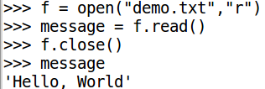
Python Interpreter: Files
Let’s read the file we just wrote to.
Notice that there’s a bit different here. We used “r” in the buffer, which tells it to open the file in read-only mode. This is safe, and files you’re just reading should always be opened this way.
f.read() reads all the contents of the file and we assign that to message.
Note: Notice that though we used double-quotes when assigning the value of message, the interpreter returned it using single quotes. This is normal, and doesn’t really matter.

Slide 15
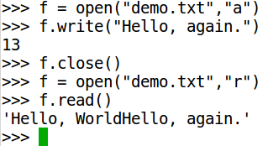
Python Interpreter: Files
Let’s see how to add a second line to that file.
“a” is the append to buffer mode.
It is used when you want to add to a text file.
Note: Notice how there’s no new line between Hello, World and Hello, again.
Why do you think that is?

Slide 16
Python Data-Types
Python allows you to store several kinds of data.
Some of the simplest ones that it supports out of the box are:
Integers: Whole numbers like 1, 2, 42, 900 etc.
Floating point values: Decimal values like 3.14152, 1.21, 42.00 etc.
Strings: Words, or characters. These come between single or double quotes: “Hello, world”, “The answer is 42”, “10” etc are strings.
Lists: A list is like a vector. It is a sequence of other values, which can be anything. [1, 2, 3, 4, 5], [“This”, “is”, “a”, “list”, “.”], [“123”, 12, “falafel”, “2014-10-22”] are all valid lists.
Boolean Values: True/False.
Dictionaries: We’ll discuss this later.

Slide 17

Lists
A list in python can be used for a lot of interesting things. Let’s try them out.
Type that exactly as you saw it.
You just generated a list. You wanted a sequence of 10 numbers, and Python gave them to you. Interestingly, it starts at 0.
In a list, each element has an address, identified by its position. List items are called by their identifier, and in this list, the identifiers are equal to the value that you see above.
The first item in a list i is i[0]. The 10th item is i[9].
Lists are very powerful, and they can be used to do many things. We will be using lists a lot, so if you have questions, this is a good time to ask them.

Slide 18
Questions?
So far, you should be able to launch python on your computer, and use it like a calculator.
You might think you haven’t learnt much, but there’s a lot to take in.
Try this out:
>>> a = list(range(10, 15))
What values do you think you will see?

Slide 19

Questions?
range() is a function that takes 1 mandatory argument, and one optional one.
Range(10), gives a range of numbers from 0 to 9, and range(10, 15), gives a range of numbers from 10 to (15-1).
In Python 2.x, range() gives you a list, and you do not need to use list(range()).
Python 3.x improved the capability of range and that makes it necessary to use list().
However, there are many uses for range() without the list() function.

Slide 20
Part 2: Program Structure
Conditional Statements
Iteration

Slide 21
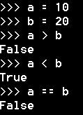
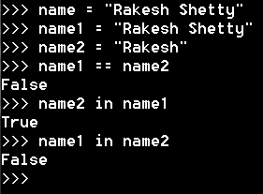
Conditional Statements
You can’t get very far using python just as a glorified calculator.
It’s powerful for making decisions.
Let’s try some comparison statements first.

Slide 22
Comparators
Python offers a few comparators:
> greater than; use for numbers
< less than; use for numbers
== is equal to; use for any kind of object.
!= not equal to; use for any kind of object.
Python also offers a few special comparators:
“in” to check if a string is in another string.
“not” to negate the condition, also equivalent to !()

Slide 23
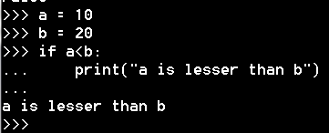
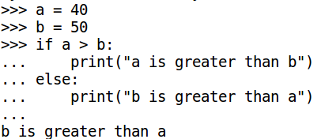
Conditional Statements
The if statement.
The segment after the “:” is a block. For every block, add 4 spaces in the immediately following line. Add 4 more spaces if you have more blocks.
The if-else statement:

Slide 24
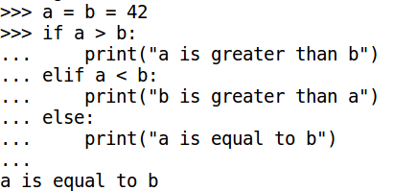
Conditional Statements
The else portion will only execute if the if section is false.
If-elif-else

Slide 25
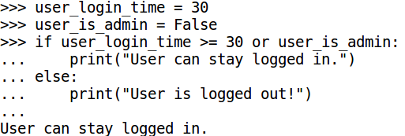
Conditional Statements
Complex Conditionals:

Slide 26
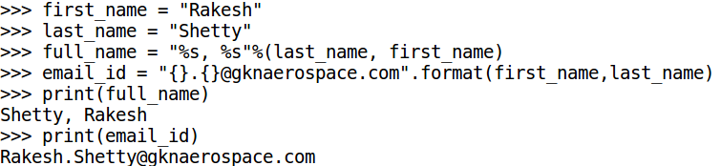
Fun With Strings
Before we go further, it’s useful to know how you can do things with strings.
Try this:
String Modifiers:
%s : string
%d : integer
%f : floating point value
Python 3.x encourages the use of “{}”.format(var) to put values in a string.

Slide 27
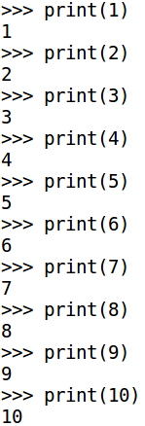
Iteration
Loops!
One of the advantages of coding is that we are able to make code do repetitive things with ease.
Take the example of printing numbers from 1 to 10.
Typing that statement so many times is laborious, but it may seem trivial.
But try thinking of your daily work and think of the situations where you do the same thing over and over again.
It may very well be possible to write a script so that you can automate this.
This looping operation is called iteration.

Slide 28
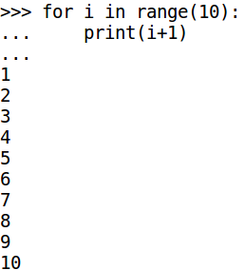
Iteration: For loop
The previous problem:
This is where range() is useful without using the list() function. Objects like range() are called iterables. They can be looped through.
Read this as:
for every item in a range of ten items starting at 0, print a value that is 1 greater than the item’s value.
Remember, 4 spaces when starting a block. That’s the pythonic way.

Slide 29
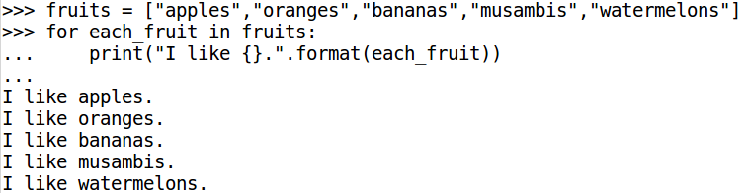
Iteration: For loop
Try this:
Every list is an iterable. It can be looped through.
Read this example closely and ask questions if you need to.

Slide 30
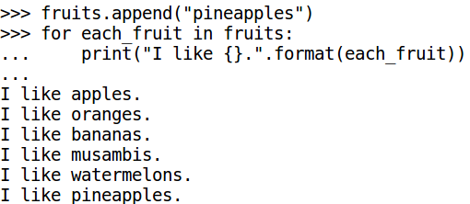
Iteration: For Loop
Let’s try that again, with a new list function.
The append function appends a value to the end of a list. It makes a permanent change to a list.

Slide 31
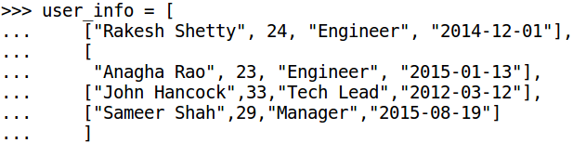
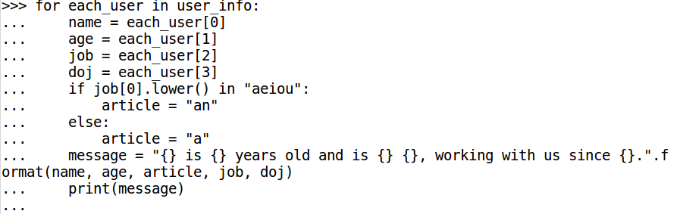
Iteration: For Loop
Try this:

Slide 32
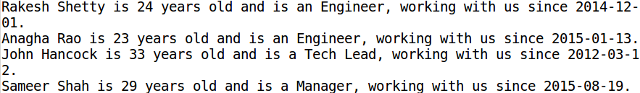
Iteration: For Loop
Output:

Slide 33

Iteration: While Loop
How do you do things forever?
Hit CTRL-C to exit out of this. This is an infinite loop. It’s useful in some scenarios.
CTRL-C is used to exit out of any Python command, if your script ever fails in some point, hit this combination to exit.
Also, take a moment and check the value of a now. It will be quite huge, no matter how fast you hit CTRL-C.

Slide 34
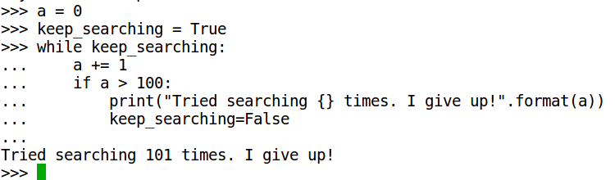
Iteration: While Loop
While is used to do things for as long as a condition is True.

Slide 35
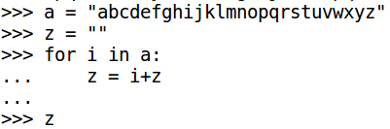
Questions?
Loops are very useful when you’re trying to do things repetitively.
At this point, you should be able to write a loop, no matter how simple. If you have questions, use this break to ask them.
Here’s some food for thought:
What will this give you?
How does this work?
What does it mean to add two strings?

Slide 36
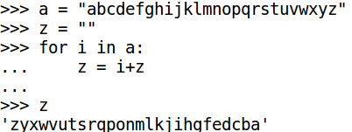
Questions
There might be easier ways to do this, of course. But remember, it’s not always a bad thing to write long code.
You’re going to learn the import command next.

Slide 37
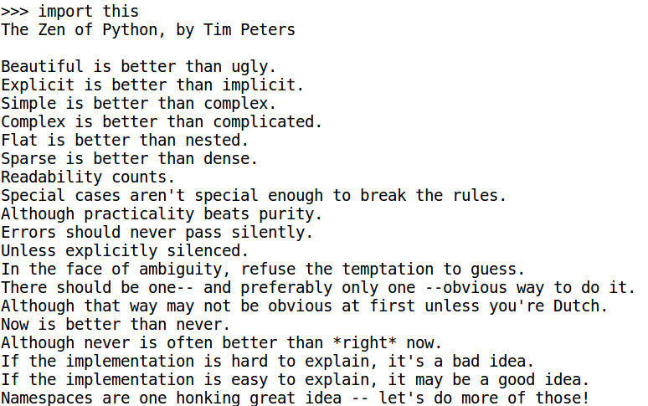
Session 3: The Zen of Python

Slide 38
Modules
Python is everything it is because of its modules.
It has numerous built-in modules, and almost innumerable third-party modules.
A module is a “library”. It allows you to use “functions” written by someone else.
A function is a piece of reusable code. So before you even learn how to write those, it’s useful to learn how to use built-in functions and modules.
But first!

Slide 39
Writing *.py files.
It’s easier to write python code in an editor, once you know your logic anyway.
In Linux, use the Text Editor, Gedit, xed, nano, vim, or emacs.
In Windows, use Sublime Text Editor, Notepad++ or Ultra-Edit.
This training uses screenshots from Sublime Text Editor.

Slide 40
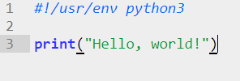
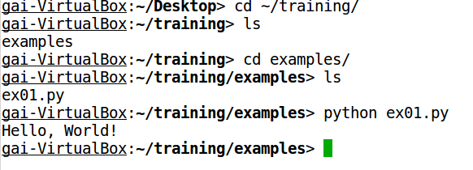
Writing Python Script Files
Open your editor and type this.
Create a folder named examples somewhere, and open it.
Now, save this as ex01.py in that folder.
In Windows, open Powershell, and in Linux, open the terminal.
Navigate to this folder using the cd command.
Once there, type python ex01.py

Slide 41
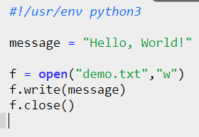
Python Scripts
Let’s try our old example again.
That first line is called a shebang. It’s used in Linux machines. Just make it a habit to use it in all your scripts, it’ll come handy some day.
It depends on machine to machine, so it might be /usr/bin/env python3 in some machines.

Slide 42
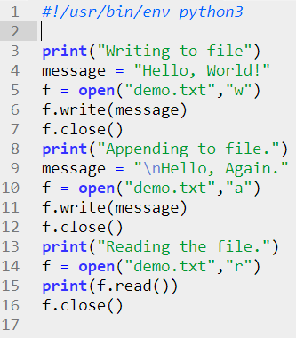
Python Scripts
Type the below example and save it to ex02.py

Slide 43
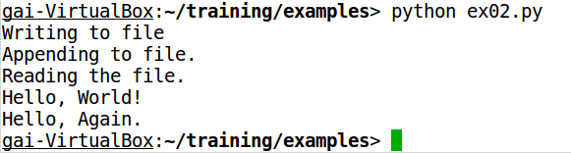
Python Scripts
Run this script in the terminal by typing python ex02.py
Note: There’s a difference. Hello, World! and Hello, Again. have appeared in two lines this time. That’s because of \n.
Sequences like \n \\ and \t are called escape sequences in programming. They are “stand-ins” for other values.
For now, it’s sufficient to know that \n means new line, or carriage return.

Slide 44
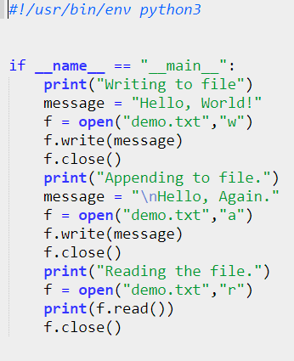
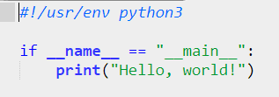
Python Scripts
What we did, though it works, is completely bad in practise. Never, ever, place any code in a script without a function.
If you must, use it this way.
You’ll see why later.

Slide 45
Back to Modules
In this session, we’ll cover the following modules:
os
csv
datetime

Slide 46
Module: os
os is a multi-platform operating system information handling module. It gives you information about the directories, the OS that you’re running the code on and so much more.
Right now, it’s enough to know that it’s used to get around the computer your script is on.

Slide 47
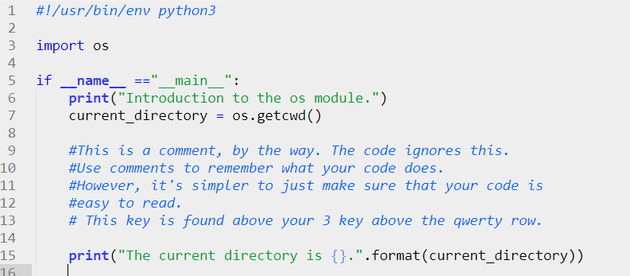
os.getcwd()

Slide 48

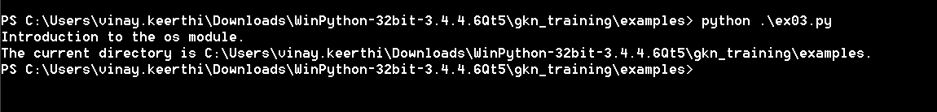
os.getcwd()
Paths are different in Linux and Windows.
In Linux, all paths begin with /
In Windows, paths are referenced from mapped drives, or network drives. They are usually like C:\my_folder\some_sub_folder or \\inblrxa18\project\RM12.
Always beware of what os you’re running. Luckily, Python takes care of that for you.

Slide 49
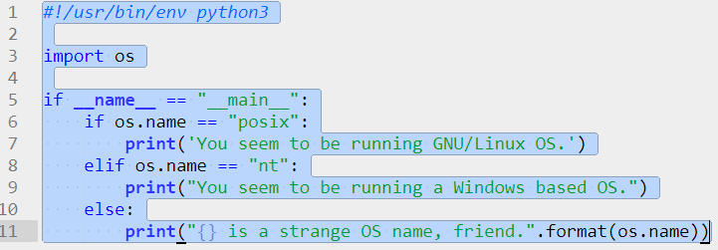
os.name
os.name either returns nt or posix, to mean either Windows or GNU/Linux.

Slide 50
os.path.join()
When you’re trying to do operations with a lot of files, you need to deal with file paths. It’s not as easy as typing C:\myfile.xml, sometimes, you will be in a loop and you will need to automatically generate a really long path.
When you do so, you’ll need to be able to use the right kind of /. Windows uses \, but Linux uses /.
Even if you’re not writing scripts for two operating systems, you’ll need to understand how to automatically build a folder name
A use case could be:
\\caeroot\[project-title]\[year]\[nc-number]\analysis\run_[number]\
When dealing with such paths, you will need to be able to join them together, or split them.

Slide 51
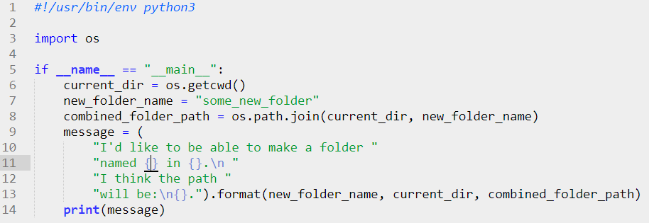
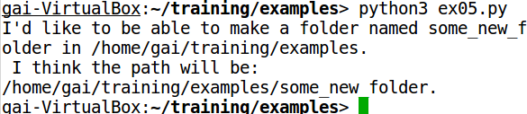
os.path.join()

Slide 52
A Pause for Dictionaries
Lists are powerful, but you need to remember the position of your variable to get the value. If you have a small list like [name, age, designation, date of joining] that may be possible, but how will you remember the order when dealing with a 25 column table?
Python Dictionaries are like lists, but instead of having a number as their identifier, they use a hash table. In other words, dictionaries use meaningful strings to index other values.

Slide 53
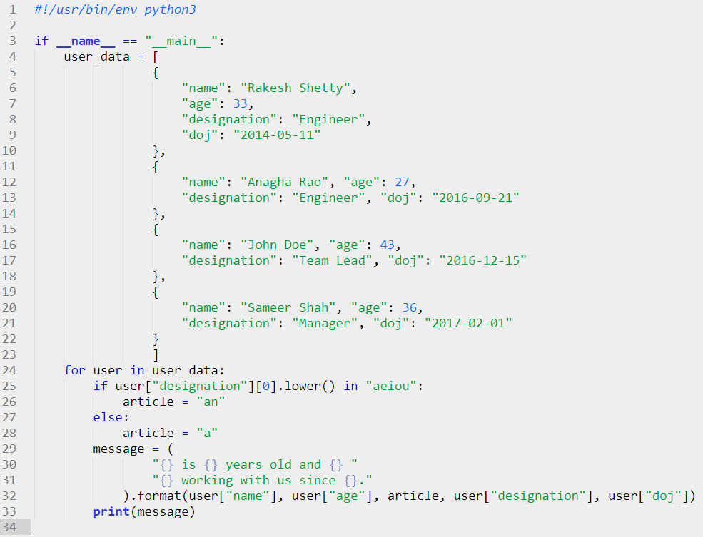
Dictionaries: Example

Slide 54
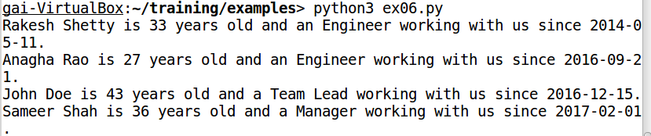
Dictionaries: Example
Dictionaries can have any kind of value, but the index should be hashable. That is, it can even be a number, but it should be unique and comparable to each other value.

Slide 55
Other os. functions
How to check if a file exists:
os.path.isfile()
How to check if a directory exists:
os.path.isdir()
How to check if a specified path exists. Could be a file or a folder.
os.path.exists()
How to make directories:
os.makedirs()

Slide 56
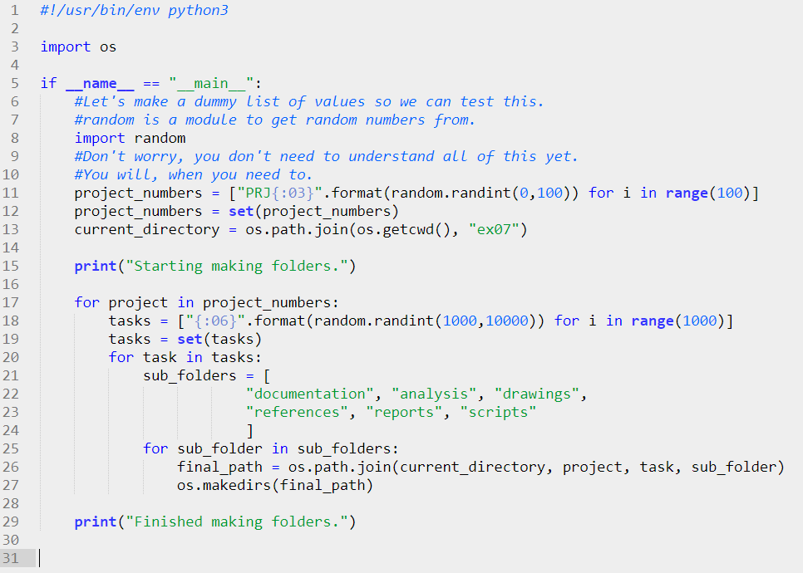
os Example

Slide 57
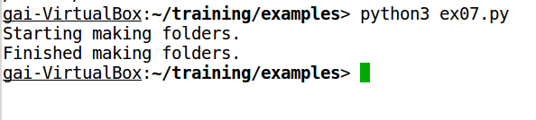
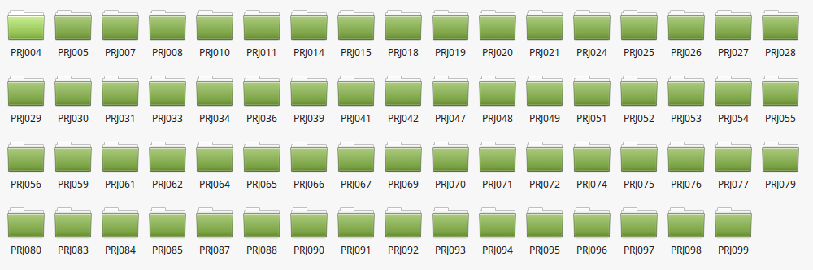
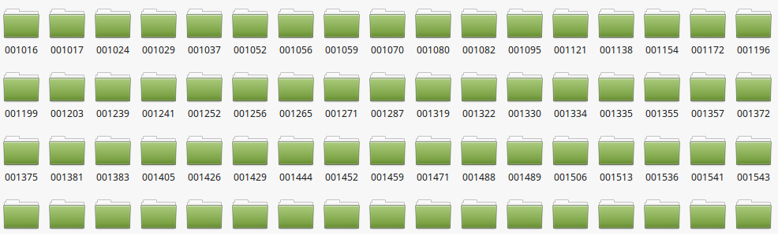
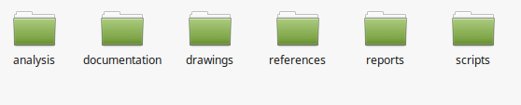
os Example

Slide 58
os Discussion
Feel free to ask questions here.
Try running that script again, and again. Don’t delete the previous folders your script creates.
What error did you get?
What do you do when you get errors?

Slide 59

Module: datetime
Python’s datetime modules comes with some powerful functions to get the date and time.
Let’s try it out in the interpreter.
The datetime module comes with several other modules inside it. One of them is also called datetime.
Other modules are date and time.

Slide 60


datetime.date()
datetime.datetime.now() gives a lot of unnecessary information. So if you just want the date:
To get to a specific date, just give the information about the date.

Slide 61


datetime.time()
datetime.datetime.now() returns a datetime.datetime object, which also has functions called date() and time() attached to it.
Time is specified easily.

Slide 62
Getting date or time from a string.
Many times, we have time in some strange format in a file, and we can read it as a string. However, how do we extract the datetime from it?
We use datetime.datetime.strptime()

Slide 63
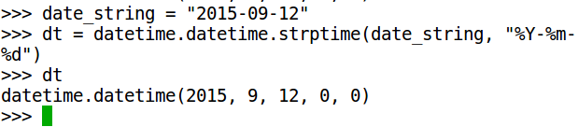
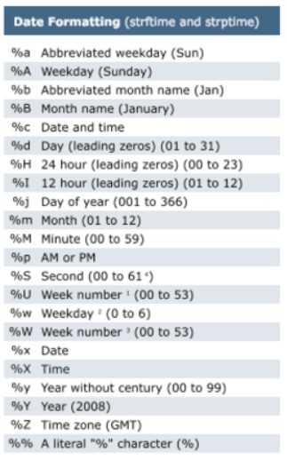
datetime.strptime cheatsheet
strptime is very useful when reading from a large dataset which has the date and time in some strange format.
strftime does the exact opposite. It allows you to put date and time in a format of your choosing. Try it out.

Slide 64
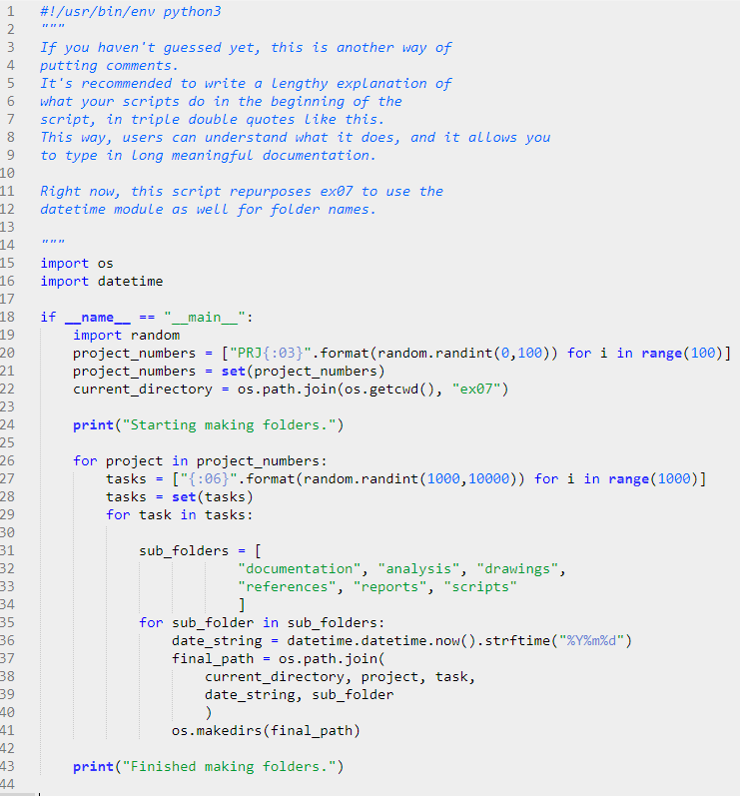
Datetime Example ex08.py
Try this script.
Run it and see what is different from ex07.py

Slide 65
Reading User Input
Next week, we’ll cover a few intermediate topics, such as reading user input, in detail.
We’ll also use csv files, which you’d normally use with Excel.
In addition, we’ll see how to get data from an existing files and learn things about them.
Before we close, here’s how you get user input.

Slide 66
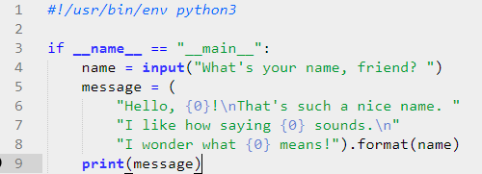
Exercise
Run this and see what happens!
Try to get it to ask you your age and print it out.
Now try making it print your name thrice.

Slide 67
Questions
This closes the first session on Basic Python.
Return for the second session if you’re interested in knowing how to copy files, how to read and write to a csv, and how to search for stuff inside files.

